Slide 1
Operating Systems
Chapter 3 (a)
Process Management
Hammad Afzal
hammad.afzal@mcs.edu.pk
Department of Computer Software Engineering
National University of Sciences and Technology

Slide 2
Roadmap
Process Concept
Process Scheduling

Slide 3
Objectives
To introduce the notion of a process -- a program in execution, which forms the basis of all computation
To describe the various features of processes, including scheduling, creation and termination, and communication
To describe communication in client-server systems

Slide 4
Process Concept
Process is unit of work in modern systems.
Process – a program in execution; process execution must progress in sequential fashion
A System consists of a collection of processes:
OS processes executing system code
User processes executing user code.
The terms job and process almost interchangeably.
Notes:
A unit of activity characterized by the execution of a sequence of instructions, a current state, and an associated set of system instructions

Slide 5
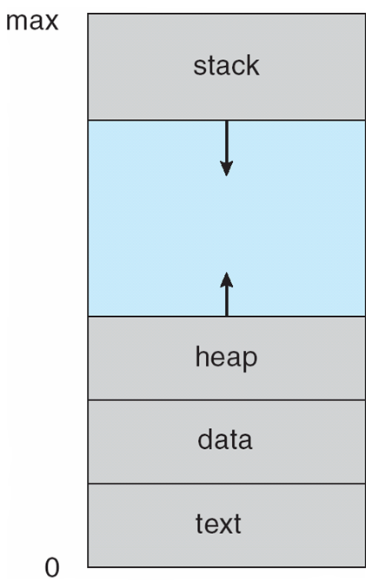
Process Concept
A process includes:
Text section
Current Activity
Stack
Data Section
Heap
Notes:
The reason for using the term “Job” is that, most of the terminology used in OS now were actually first introduced in time of Batch Systems.

Slide 6
Process Concept
Text Section:
Program Code
Current Activity:
Program counter and contents of processor registers.
Stack containing temporary data
Function parameters, return addresses, local variables
Data section
Contains global variables
Heap
Contains memory dynamically allocated during run time
Notes:
The reason for using the term “Job” is that, most of the terminology used in OS now were actually first introduced in time of Batch Systems.

Slide 7
The Process
Program is passive entity
A file containing list of instructions stored on disk (executable file).
Process is active
Program becomes process when executable file loaded into memory.
A program counter having next instruction to execute and other set of associated resources.
Execution of program started via GUI mouse clicks, command line entry of its name, etc

Slide 8
The Process
Two processes may be associated with the same program.
Several users running different copies of same program.
One user opening several copies of same program. E.g. Web browser (Text section is same, but heap, pointers etc are different)

Slide 9
Process State
As a process executes, it changes state
State defined in Current Activity
New: The process is being created
Running: Instructions are being executed
Waiting: The process is waiting for some event to occur (I/O completion or reception of signal)
Ready: The process is waiting to be assigned to a processor
Terminated: The process has finished execution

Slide 10
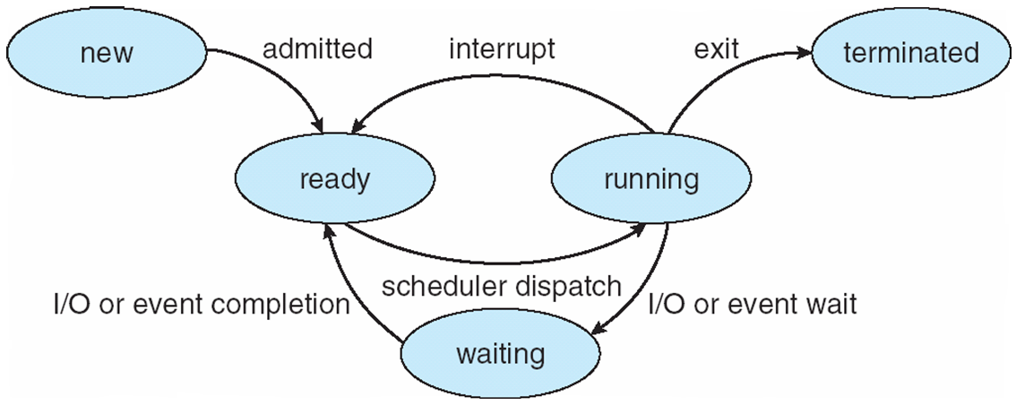
Diagram of Process State

Slide 11
Process Control Block (PCB)
Process represented by PCB
(also known as Task Control Block)
Information associated with each process
Process state
Program counter
CPU registers
CPU scheduling information
Memory-management information
Accounting information
I/O status information

Slide 12
Process Control Block (PCB)
Process represented by PCB
(also known as Task Control Block)
Process state: May be new, ready, running, waiting, halted etc.
Program counter: Indicates the address of next instruction to be executed for this process.
CPU registers: accumulators, index registers, stack pointers, and general purpose registers.
They must be stored as well when an interrupt occurs.

Slide 13
Process Control Block (PCB)
CPU scheduling information:
process priority information, pointers to scheduling queues and other parameters.
Memory-management information: value of base and limit registers, page tables etc
Accounting information: Amount of CPU used, time limits, job or process numbers etc
I/O status information: list of I/O devices allocated to process, a list of open files and so on.

Slide 14
Context Switch
When CPU switches to another process, the system must save the state of the old process and load the saved state for the new process via a context switch.
Happens in case of interrupts too.
Context of a process represented in the PCB.
Value of CPU registers, process state and memory management functions.

Slide 15
Context Switch
Context-switch time is overhead; the system does no useful work while switching
Speed varies with memory speed, the number of registers that must be copied and existence of special instructions (e.g. single instruction to load all registers)
Time dependent on hardware support
Some hardware provides multiple sets of registers per CPU -> multiple contexts loaded at once.
Context switch only requires change of pointer to current set of registers.

Slide 16
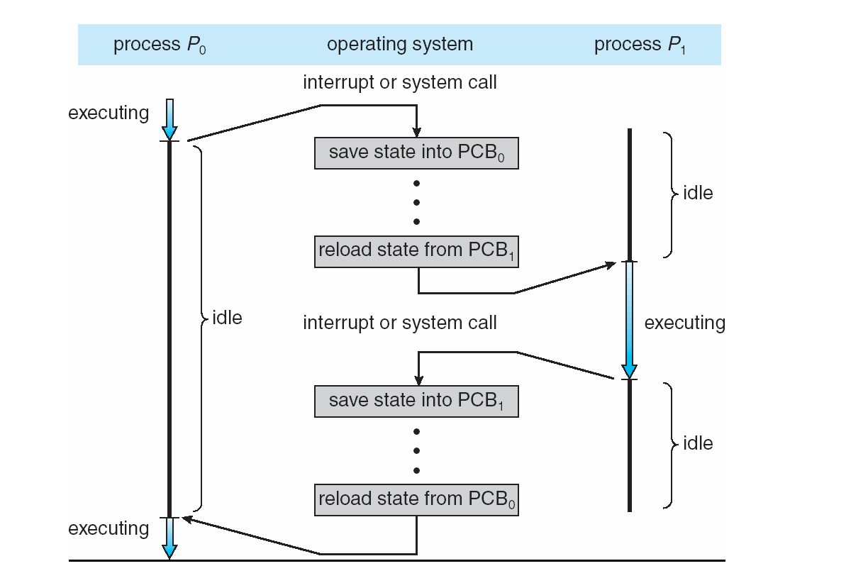
CPU Switch From Process to Process

Slide 17
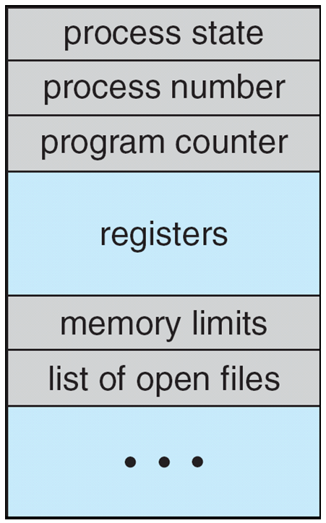
Process Control Block (PCB)

Slide 18
Process Scheduling
Maximize CPU utilization,
Quickly switch processes onto CPU for time sharing, so user can interact with multiple programs.
Process scheduler selects among available processes for next execution on CPU
Also known as Dispatcher: a small program which switches the processor from one process to another
The behavior of an individual process is shown by listing the sequence of instructions that are executed. This list is called a Trace

Slide 19
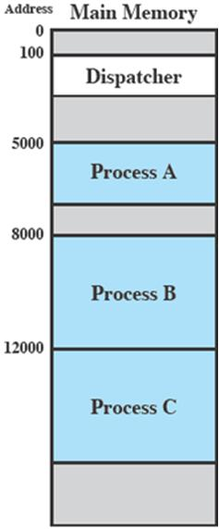
Process Execution
Consider three processes being executed
All are in memory (plus the dispatcher)
Lets ignore virtual memory for this.

Slide 20
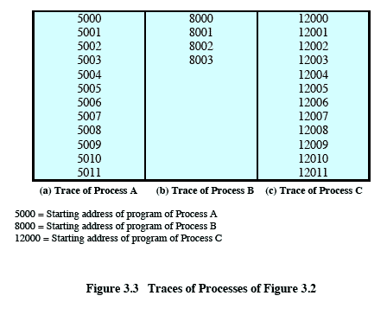
Trace from the processes point of view:
Each process runs to completion
Notes:
Animated slide
Wipes down to give impression of process progression

Slide 21
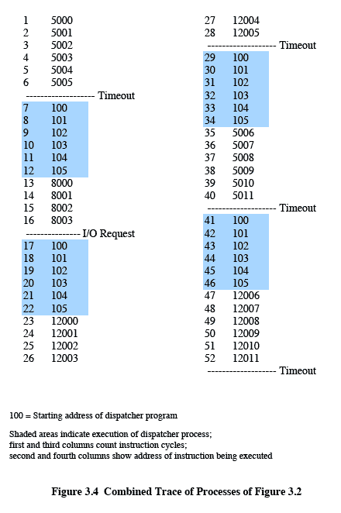
Trace from Processors point of view
Timeout
Timeout
Timeout
I/O
Notes:
Animated slide
Explain the scenario then click for the animation
The shaded areas represent code executed by the dispatcher.
The same sequence of instructions is executed by the dispatcher in each instance because the same functionality of the dispatcher is being executed.
We assume that the OS only allows a process to continue execution for a maximum of six instruction cycles, after which it is interrupted; this prevents any single process from monopolizing processor time.
Animate here
The first six instructions of process A are executed, followed by a time-out and the execution of some code in the dispatcher, which executes six instructions before turning control to process B2.
After four instructions are executed, process B requests an I/O action for which it must wait. Therefore, the processor stops executing process B and moves on, via the dispatcher, to process C.
After a time-out, the processor moves back to process A. When this process times out, process B is still waiting for the
I/O operation to complete, so the dispatcher moves on to process C again.

Slide 22
Process Scheduling
Queues
System maintains scheduling queues of processes
Job queue – When process enters in system, it is put into a job queue, which consists of set of all processes in the system.
Ready queue – set of all processes residing in main memory, ready and waiting to execute.
This queue is generally stored as linked list.
Queue header contains pointers to first and final PCBs in list.
Each PCB includes a pointer to next PCB.

Slide 23
Process Scheduling
Queues
System maintains scheduling queues of processes
Device queue
Set of processes waiting for any particular I/O device is called a device queue.
Processes migrate among the various queues

Slide 24
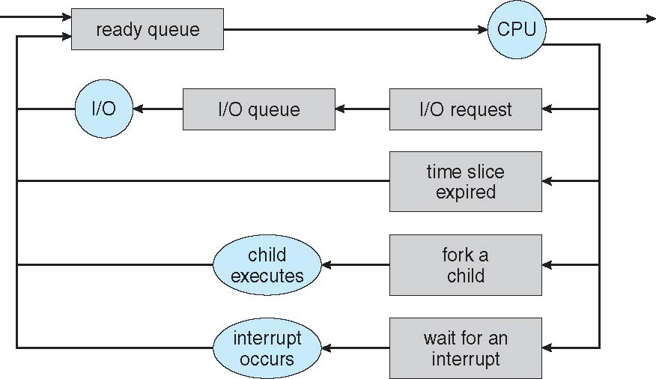
Representation of Process Scheduling

Slide 25
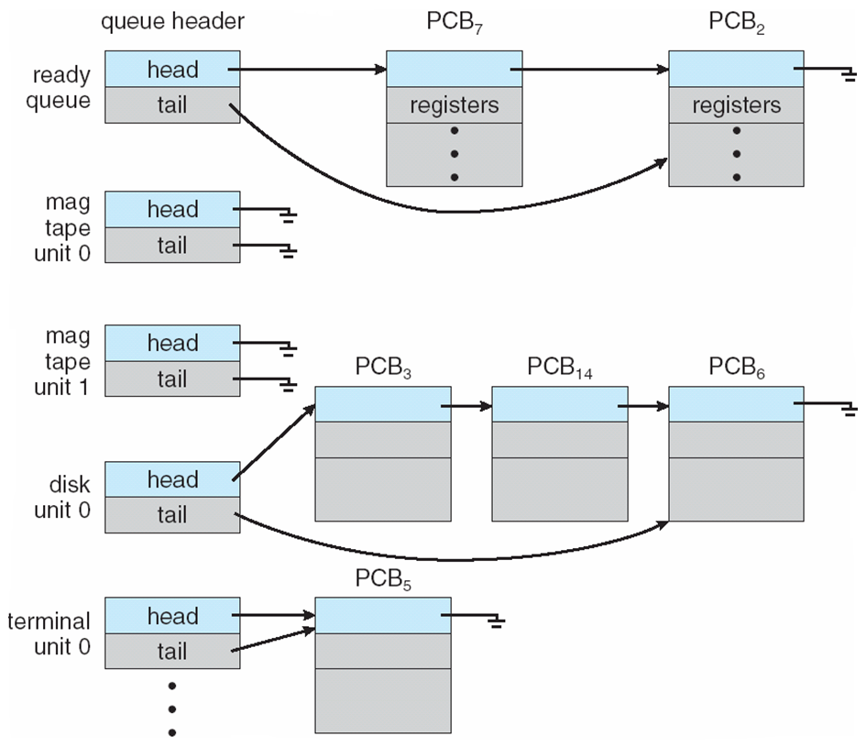
Ready Queue And Various I/O Device Queues

Slide 26

Schedulers
Process migrates among various scheduling queues throughout its life time.
Batch System:
Processes spooled to mass-storage device.
Long-term scheduler (or job scheduler) – selects which processes should be brought into the memory (ready queue)
Short-term scheduler (or CPU scheduler) – selects which process should be executed next and allocates CPU

Slide 27
Schedulers (Cont.)
Short-term scheduler is invoked very frequently (milliseconds) ⇒ (This scheduler must be very fast)
Long-term scheduler is invoked very infrequently (seconds, minutes) ⇒ (This scheduler can afford to be slow)
It also controls the degree of multiprogramming

Slide 28
Schedulers (Cont.)
Processes can be described as either:
I/O-bound process – spends more time doing I/O than computations, many short CPU bursts
CPU-bound process – spends more time doing computations; few very long CPU bursts
Long term scheduler must select a good process mix of I/O bound and CPU bound.

Slide 29
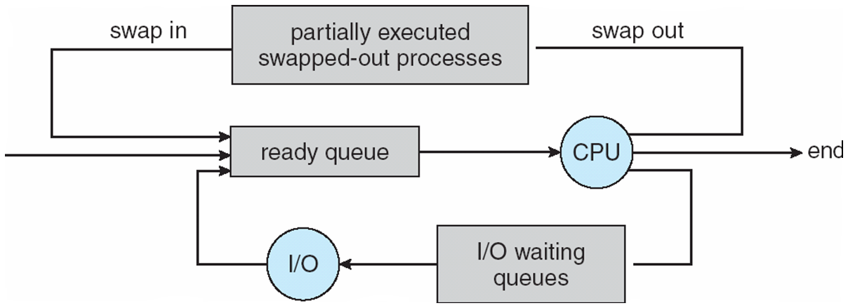
Schedulers (cont..) Addition of Medium Term Scheduling

Slide 30
Suspended Processes
Processor is faster than I/O so all processes could be waiting for I/O
Swap these processes to disk to free up more memory and use processor on more processes
Blocked state becomes suspend state when swapped to disk
Two new states
Blocked/Suspend
Ready/Suspend
Notes:
Mention that the aim is to fully utilize the processor.

Slide 31
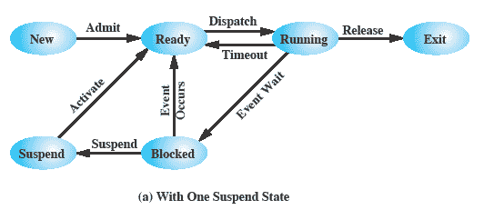
One Suspend State
Notes:
Again, the simple solution is to add a single state – but this only allows processes which are blocked to be swapped out.

Slide 32
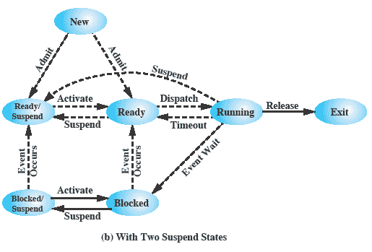
Two Suspend States
Notes:
Two suspend states allow all processes which are not actually running to be swapped.
Run through the four states:
Ready: The process is in main memory and available for execution.
• Blocked: The process is in main memory and awaiting an event.
• Blocked/Suspend: The process is in secondary memory and awaiting an event.
• Ready/Suspend: The process is in secondary memory but is available for execution as soon as it is loaded into main memory.
It would be useful to also summarise the main transitions (abridged)
Blocked → Blocked/Suspend: If there are no ready processes, then at least one blocked process is swapped out to make room for another process that is not blocked. This transition can be made even if there are ready processes available, if the OS determines that the currently running process or a ready process that it would like to dispatch requires more main memory to maintain adequate performance.
Blocked/Suspend → Ready/Suspend: A process in the Blocked/Suspend state is moved to the Ready/Suspend state when the event for which it has been waiting occurs.
Ready/Suspend S → Ready: When there are no ready processes in main memory, or if a suspended process has a higher priority, the OS will need to bring one in to continue execution.
Ready → Ready/Suspend: Normally, the OS would prefer to suspend a blocked process rather than a ready one, because the ready process can now be executed, whereas the blocked process is taking up main memory space and cannot be executed. However, it may be necessary to suspend a ready process if that is the only way to free up a sufficiently large block of main memory.
Several other transitions that are worth considering are the following:
New → Ready/Suspend and New →Ready: When a new process is created, it can either be added to the Ready queue or the Ready/Suspend queue. In either case, the OS must create a process control block and allocate an address space to the process. It might be preferable for the OS to perform these housekeeping duties at an early time, so that it can maintain a large pool of processes that are not blocked. With this strategy, there would often be insufficient room in main memory for a new process; hence the use of the (New → Ready/Suspend) transition.
Blocked/Suspend → Blocked: Inclusion of this transition may seem to be poor design. After all, if a process is not ready to execute and is not already in main memory, what is the point of bringing it in? But consider the following scenario:
A process terminates, freeing up some main memory.
There is a process in the (Blocked/Suspend) queue with a higher priority than any of the processes in the (Ready/Suspend) queue and
the OS has reason to believe that the blocking event for that process will occur soon.
Under these circumstances, it would seem reasonable to bring a blocked process into main memory in preference to a ready process.
Running → Ready/Suspend: Normally, a running process is moved to the Ready state when its time allocation expires. If, however, the OS is pre-empting the process because a higher-priority process on the Blocked/Suspend queue has just become unblocked, the OS could move the running process directly to the (Ready/Suspend) queue and free some main memory.
Any State → Exit: Typically, a process terminates while it is running, either because it has completed or because of some fatal fault condition. However, in some operating systems, a process may be terminated by the process that created it or when the parent process is itself terminated. If this is allowed, then a process in any state can be moved to the Exit state.

Slide 33
Threads
So far, we have implied that
Process is a program that performs a single thread of execution.
This allows the process to perform only one task at one time.
Example Limitation. In a word processor program, user can not type in characters and perform spell checker simultaneously within the same process.

Slide 34
Threads
Modern OS provides processes with multiple threads of executions (perform tasks more than one at one time).
In such systems, PCB is extended to have information about threads.
(Details in Chapter 4)

Slide 35
Some Code Snippets Not Included in Theory Exams

Slide 36
Process Representation in Linux
PCB is represented by the C structure task_struct
pid t pid;
/* process identifier */
long state;
/* state of the process */
unsigned int time slice
/* scheduling information */
struct task_struct *parent;
/* this process’s parent */
struct list head children;
/* this process’s children */
struct files struct *files;
/* list of open files */
struct mm struct *mm;
/* address space of this pro *

